Slide 1
Types of Computer
Understanding Computers

Slide 2
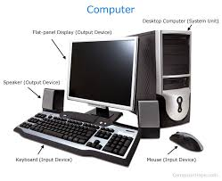
What is computer
A computer is electronic device, Capable of computation and making logical decision million or even billion times faster then human being. With the growing AI, computers also have learning capabilities from the data provided. The input and output data can be in different forms like text, images, audio and video. A computer processes the input according to the set of instructions provided to it by the user and gives the desired output. Computers are of various types and they can be categorized in two ways on the basis of size and on the basis of data handling capabilities.

Slide 3
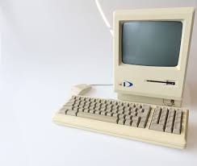
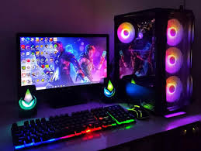
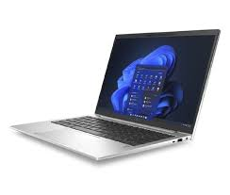
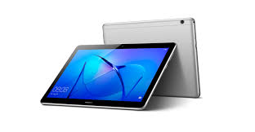
Types of Computer
Computers can be classified based on two key factors: size and data handling capabilities. In this presentation, we'll explore the different types of computers according to these criteria. Let's first take a look at the various types of computers:
- Supercomputer
- Mainframe Computer
- Minicomputer
- Personal Computer (PC)
- Tablets and Smartphones

Slide 4
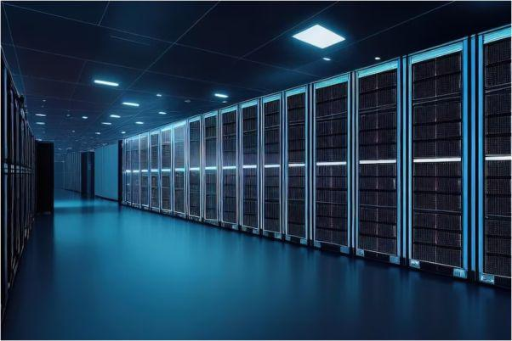
Super Computers
-They are the fastest computers available
– They are made up of 100s of 1000s of processors
– They are usually developed for running specialised scientific applications and calculations
• Weather forecasting
• Astronomy applications
• Scientific simulations
– NASA needs supercomputers!
– They are generally not used by multiple users at a time

Slide 5
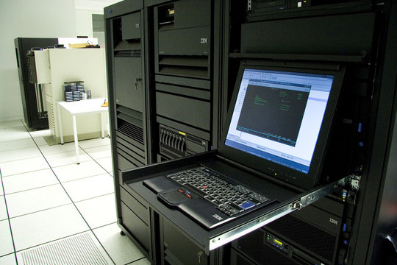
Mainframe computers
– A high-performance computer used for large information processing jobs.
– They are also multi-user computers.
– They can support 1000s of users simultaneously.
– Mostly used in very large organisations, like banks to process million of transaction taking place
.– Mainframe computer can fit in a small room.

Slide 6
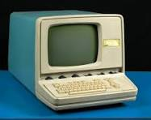
Minicomputers
They are also called mid-range computers.
– They are multi-user computers. Multiple users in an organisations connect to minicomputers to perform their tasks.
– Minicomputers are used by small organizations.
– 100s of users can connect to minicomputers at a time
– The size of minicomputer can be up to size of a washing machine
– “Minicomputer” is a term that is no longer used much. In recent years, minicomputers are often referred to as small or midsize servers (a server is a central computer that provides information to other computers).

Slide 7
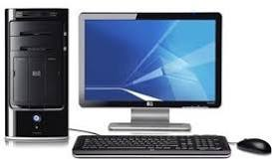
Personal Computer (PC)
They are also called microcomputers.
– PC is a relatively small computer and cheaper computers designed for individual users
– CPU is built on one chip
– “Microcomputer” is now primarily used to mean a PC, but it can refer to any kind of small computer, such as a desktop computer, laptop computer, tablet, smartphone, or wearable.
– PC is used for applications like, Word-processing, accounting, desktop publishing, and spreadsheet and database applications.

Slide 8
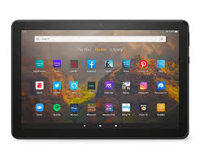
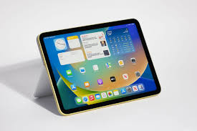
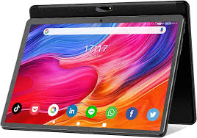
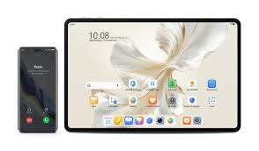
Tablets
– It is a thin, lightweight, wireless portable personal computer with a touchscreen interface.
– The tablet form factor is typically smaller than a notebook computer, but larger than a smartphone.

Slide 9
THE END THANK YOU

